Slide 1

Notes:
Hello all and welcome to our 4 year anniversary celebration event.
It’s lovely to see so many of you here today – we appreciate you allocating time to be here.
For those who don’t know me, my name is Rachel Arnold and I am one of the Directors of Panda Education.
Just before we start we just want to get the Zooming right, so I will pass you over to Ros Protheroe, my fellow Director, who will ensure you have your settings correct.
Zoom – fit to window
Speaker view
Mute mics
Questions in chat
Permission to record
Thanks Ros

Slide 2
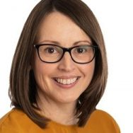
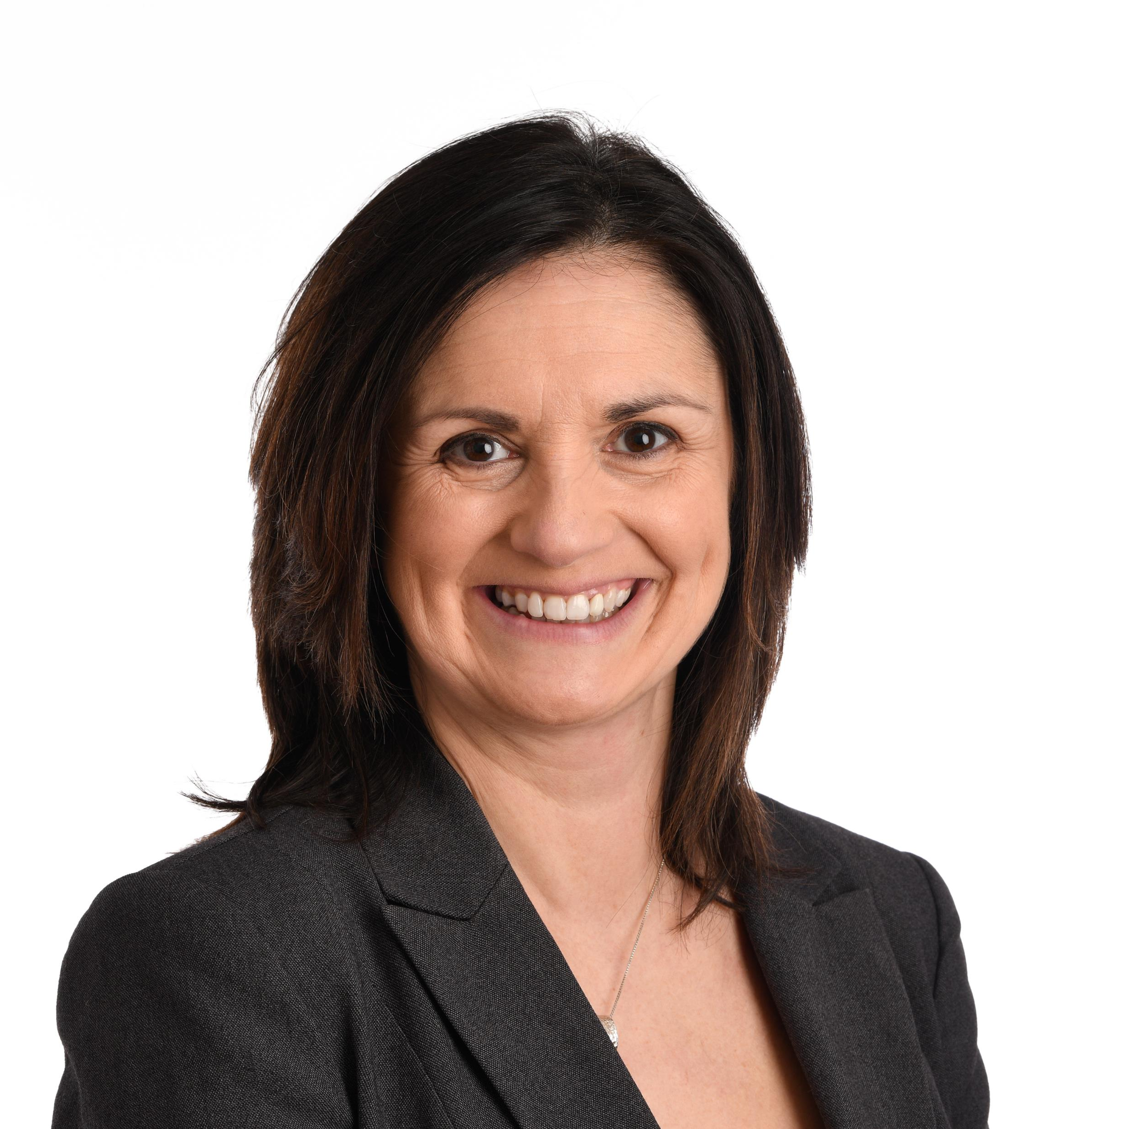
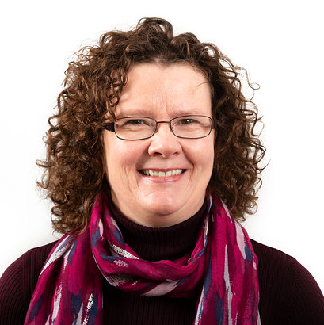

Team Panda
Notes:
We have worked with lots of you before, but for those of you who are new to us, I’ll just give you a brief background to Panda, and why we started the company.
Ros and I have worked in post 16 education – apprenticeships, traineeships, adult employability for over 20 years. We met at a large training provider, where I was Director of Quality and Ros was Head of Staff Development. We felt that the most important route to raising standards was through professional development, but, we could never find anything that suited our industry – we are not like schools! We actually thought – “we could do better ourselves” – so we did! We set up Panda to provide professional learning opportunities for those tutors, trainers and assessors working in post-16 education.
2 years ago to take on an additional member of the team – Nikki Ryall, who you will meet later, whose has a wealth of experience in adult community education and mental health and this allowed us to expand our delivery to include the Learning and Development Apprenticeship and Mental Health and Wellbeing courses.

Slide 3







We’ve been busy!
Over 100 trainer, assessor, and IQA qualifications delivered
25 successful mental health accreditations
Over 1000 people trained on bespoke courses (including NTFW, Urdd, Coleg Llandrillo Menai, Neath Port Talbot college (Pathways), Coleg y Cymoedd and Coleg Gwent)
100% distinctions in England management apprenticeships
Reigning winners of Caerphilly Start up Business Award!
Notes:
In our 4 years we have delivered over 100 qualifications in training, assessment IQA and mental health
We have delivered bespoke training to over 1000 post-16 education practitioners in Wales – delivering bespoke workshops on topics such as mental health, digital skills, reflective practice, British Values.
We would like to thanks all those who have supported us.
We have also had the pleasure of working with specialists to widen our offer – Dr Shan Jones in safeguarding – who you will meet later, Alun Prosser of Go Connect for Youth Work , Alison Newby for Essential Skills and Nick Barton for Management delivery – we’d like to say a big thanks to you all.

Slide 4

Today…
9:30 AM
Welcome –
Rachel Arnold
9:45 AM
Considerations for Digital Safeguarding –
Dr. Shan Jones
10:10 AM
Looking after your Mental Health –
Nikki Ryall
10:40 AM
Tips for Taking your Training Online –
Ros Protheroe
11:10 AM
Professional Learning –
Rachel Arnold
11:30 AM
Close

Slide 5

Dr Shan Jones
Considerations for
Digital Safeguarding
Notes:
We’d like to welcome Dr. Shan Jones. Shan was formerly an Education Officer for the NSPCC. She has recently set up the CIC Positive Vibes International, which focuses on the wellbeing of children and young people. She has recently achieved her doctorate on bullying in school settings.

Slide 6

Rachel Arnold
Professional Learning

Slide 7

Welsh Government
Professional
Learning Scoping Study
Skills gaps in pedagogical skills for tutoring / teaching
  Developing questioning techniques;
  Identifying ways to structure learning to stretch learners more and incorporating this in learning activities;
  Providing constructive feedback.
Digital Skills
Mental Health and Wellbeing
Notes:
Last year a professional scoping study was commissioned by the Welsh Government to help them understand how professional learning could better support practitioners in post-16 education. They spoke with 364 staff from 30 WBL, FE and ACL providers from across Wales to gauge their experiences.
Have full report open in window
Ask Fiona for comment - unmute
There were some interesting findings which included that there were as follows:

Slide 8

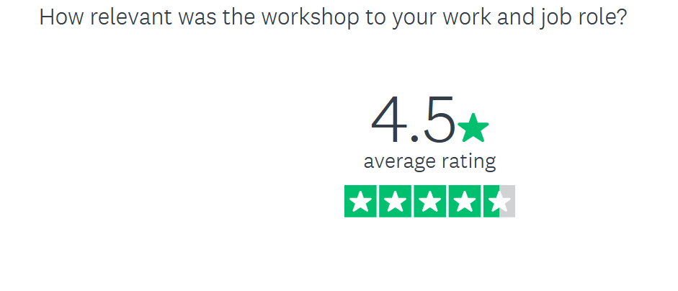
September 23rd – Reflective Practice
October 8th – Essential Skills – Numeracy – Controlled Task Tips
October 19th – Planning and Target Setting
November 26th – Feedback for Learning and Progression
December 15th – Taking Teaching and Learning Online
January 20th – Learner Wellbeing
February 5th – Questioning techniques to stretch and challenge
March 16th – Professional Discussions for Assessment and Learning
https://bit.ly/pandapln
Notes:
Last year, we set up a Professional Learning Network. We had over 50 practitioners from providers across Wales join us for themed workshops. We linked the themes of the workshops to the Professional StandardsLinks to the professional standards. Delivered via Zoom. Small charge at £40pp+VAT

Slide 9
Practitioner Support
Blogs – https://www.pandaeducation.co.uk/blog/
Videos and Resources
Closed Facebook practitioner group?
Accredited Courses – Train the Virtual Trainer, Mental Health and Wellbeing, Understanding Safeguarding (as well as CAVA, IQA, AET)
Notes:
Our aim this year, is to continue to develop our networks of professional practice and support for practitioners.
Blogs - we are going to share at least one blog a month from experienced practitioners in our network. We are starting this month with Lisa Beecham – Management Apprenticeship Trainer (ACT) and Kim Jenkins Quality Manager – ALS. Next month we have one from Deb Birkett – Head or People and Product about curriculum development.
Facebook group – allow practitioners the space to ask questions – allow discussion and support each other.

Slide 10


Thank you!
Find us here:
@PandaEducationandTraining
@PandaEduLtd
/PandaEduLtd
@PandaEduLtd
www.pandaeducation.co.uk
hello@pandaeducation.co.uk
Notes:
Ros end with Thank you for sharing our special day, we hope you learnt something, and sharing resources.

