Slide 1
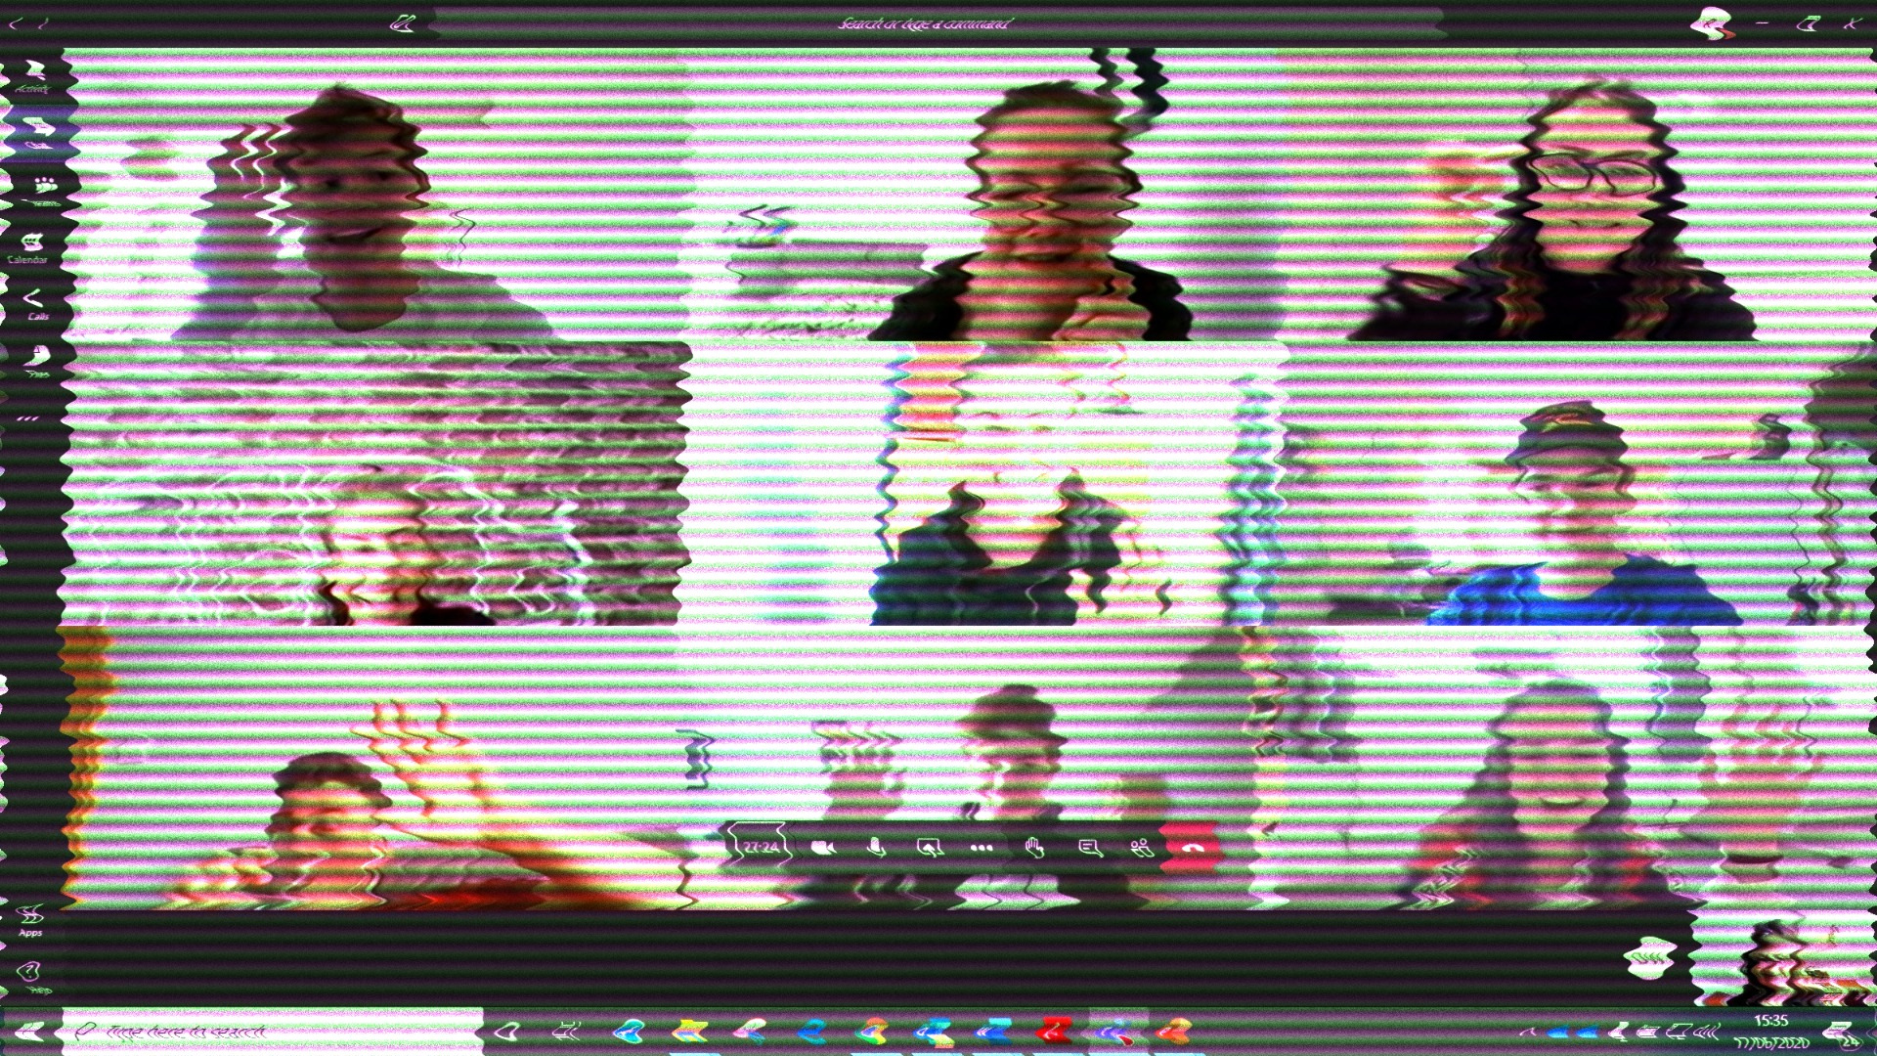
Taking Your Training Online
What we have learned

Slide 2

Coming up…
Platform
Engagement
Facilitation & Tools
Design & Structure
Can you still get the same effect online?
Top Tips
Notes:
We’ve all had to adapt, and have just got on with it. How can we make sessions more professional

Slide 3
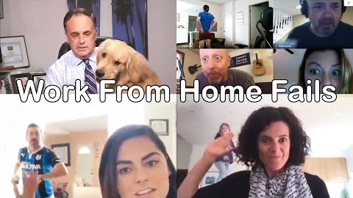
QUICK POLL
Notes:
POLL Have any of these distractopns happened to you during a video call/session?
Yes No

Slide 4

The Fundamentals…

Slide 5
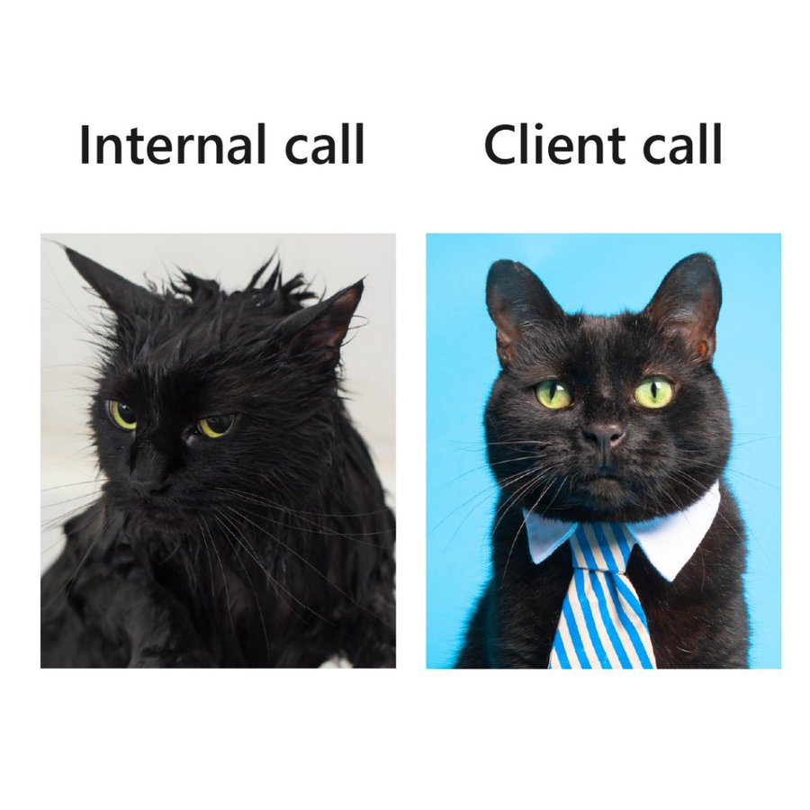
Planning for delivery
Prepare your background
Professional at ALL times! Including your background, the way you are dressed
Get rid of all distractions including pets!
Think about lighting, sound and your framing
Notes:
Prepare your background-if you don’t feel comfortable showing learners your house, use a virtual background
Professional at ALL times! Including your background, the way you are dressed
Get rid of all distractions including pets!
Think about lighting and sound -
test it out on others first don’t sit in front of a window
Virtual backgrounds

Slide 6

Platform

Slide 7





Which one?
Zoom
MS Teams
Skype
Whereby (used to be appearin)
GoTo webinar
Webex
Google Meet
…and lots of others
Notes:
1. Ask in chat-which platform do you currently use?
Goto-webinar-intended Broadcast rather than interaction
Then go through basics What did we want? Most tools for the least cost-we chose Zoom WE also use teams I use whereby for small 1-1 meetings as easy to use
Zoom-breakout rooms, chat, record –separate audio file, chat, annotate any screen and save/whiteboard, co hosts, polls, private chat
Teams-originally designed for internal organisational teams to work together, so permissions are limited as guests from outside your organisation-limits use of features such as whiteboard, file sharing etc, Feels a bit clunky, personally –I do like the chat function-file sharing
Whereby-free version-up to 4 people (good for reviews/1-1s) Good whiteboard with lots of features-mind mapping etc, screenshare, chat, record

Slide 8
Which do we use?
Zoom
MS teams
Designed for meetings and webinars
Freemium
Unlimited one-on-one meetings, screen sharing, chat, virtual backgrounds, whiteboard/annotation and more.
More features suited to online learning and easy to use
Security issues?
Designed for members of 1 organisation to communicate
Free version available
unlimited meetings, screen sharing, chat, virtual backgrounds, whiteboard and more.
Some limitations-breakout rooms only in education version (schools) There are workarounds but complicated!
Notes:
Zoom has had some awful press –early in lockdown because of zoom bombing-people gagtecrashing meetings and taking over. Zoom have resolved this issue with their new update. However-that update was advertised as fully encrypted end to end…currently a law suit in the us saying it isn’t-false advertising
Basically use all security features-lock room, enable passwords, only send invites via email etc.
We have never had any security issues so we continue to use it, following all guidelines

Slide 9
Tips
Get to know your platform-as a host AND as a participant
Explore the advanced settings-eg, allow polls, allow multiple screen shares etc
Use the best interactive platform available to you and adapt

Slide 10

Engagement

Slide 11
Live Online Learning…is NOT a webinar

Slide 12
“we have an attention span of 20 minutes…don’t we?”
Notes:
We have found this a challenge sometimes.
Distractions

Slide 13
Engagement Top Tips
For a group session-10 learners maximum
Use the tools of your platform wisely to engage
Plan in your engagements
DO NOT lecture/talk for 10 minutes then do an activity like you would in a classroom
Short and sharp-3 mins, ask a question, gauge understanding (AfL)
Notes:
For a group session-10 learners maximum
Use the tools of your platform wisely to engage
Build confidence gradually
Plan in your engagements
DO NOT lecture/talk for 10 minutes then do an activituy like you would in a classroom
Short and sharp-3 mins, ask a question, gauge understanding (AfL)
Don’t think you have to use all of the features in one session
You could even just use one feature, eg chat window, but in a variety of ways-pair people up to communicate using private chat good if there are no breakout rooms or you don’t feel comfortable using breakout rooms yet), use emoticons (green tick, red cross) Ask a question to everyone
Features-chat, unmute and talk one at a time, whiteboard, Share screen, breakout rooms, polls, external tools when you feel more confident e.g mentimeter, kahoot, nearpod…
Smaller classes-people think because its online you can pile the people in…like we have today! (This is a webinar)
To have meaningful engagement-keep the groups small
And if 1-1-don’t think you cant have activities-give time for research tasks, questions , time for answers (switch your vid off to give them time)

Slide 14

Facilitation & Tools
Creating a classroom environment in a virtual space

Slide 15
Facilitation
Keep it simple
Use a producer !
Interaction
Lesson Plan! (More on this later)
Give really clear instructions on how to use tools
Slow down
Be yourself
Smaller classes-no more than 10
Notes:
Producer-A producer sits in the background to do the behind the scenespart-manage the chat window and any questions, any tech glitches-private chat to anyone having a tech issue manage breakout rooms, set up external tools such as padlet..be prepared to take over if the tutor has tech issues-always have access to the lesson / facilitation plan

Slide 16

Tools

Slide 17

Live Tools
In Platform
Chat window (including private chat e.g. Zoom)
Whiteboard/annotation
Breakout rooms
Share screen and annotation
External
Padlet
Google / Microsoft Forms
Kahoot
Mentimeter
Nearpod
Quizalise
Youtube…& many more!

Slide 18
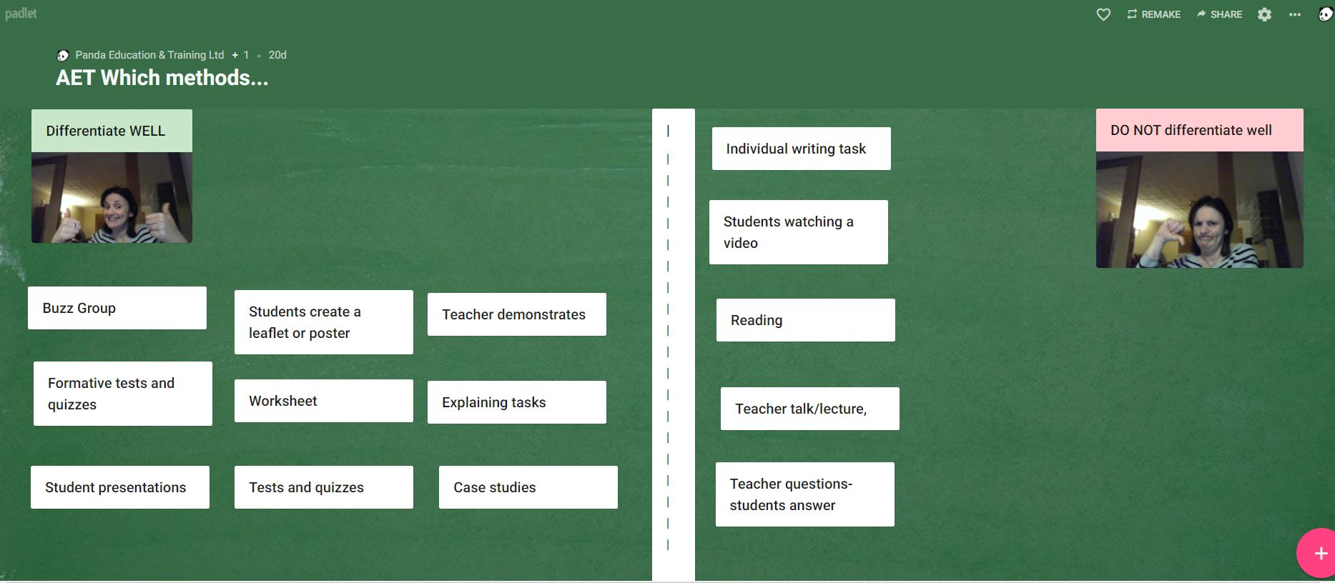
Padlet-Sorting, matching, identifying…

Slide 19
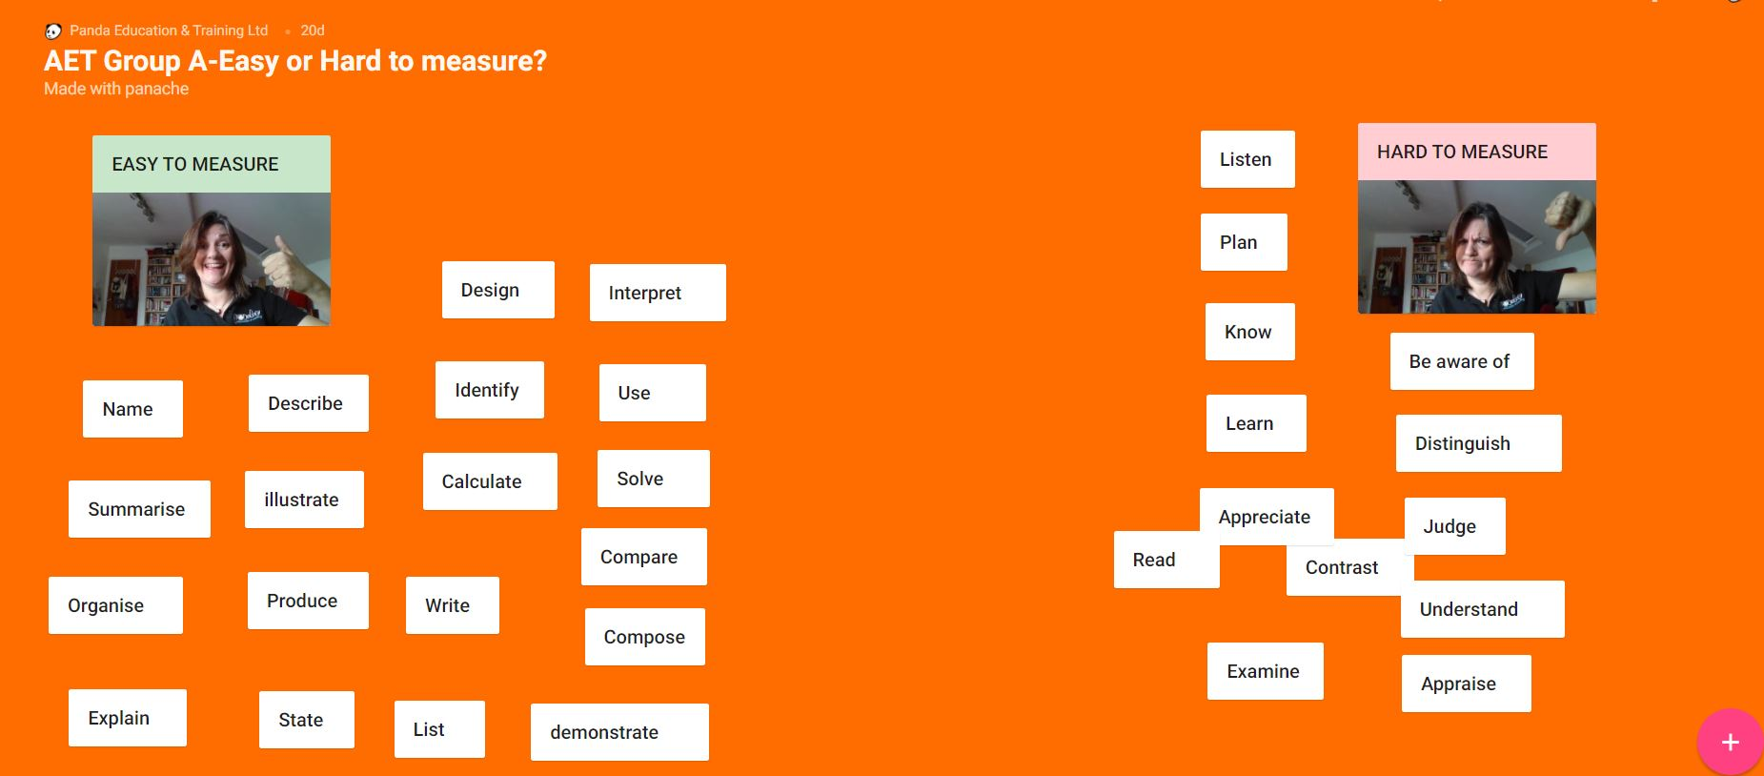
Padlet-Sorting, matching, identifying…

Slide 20
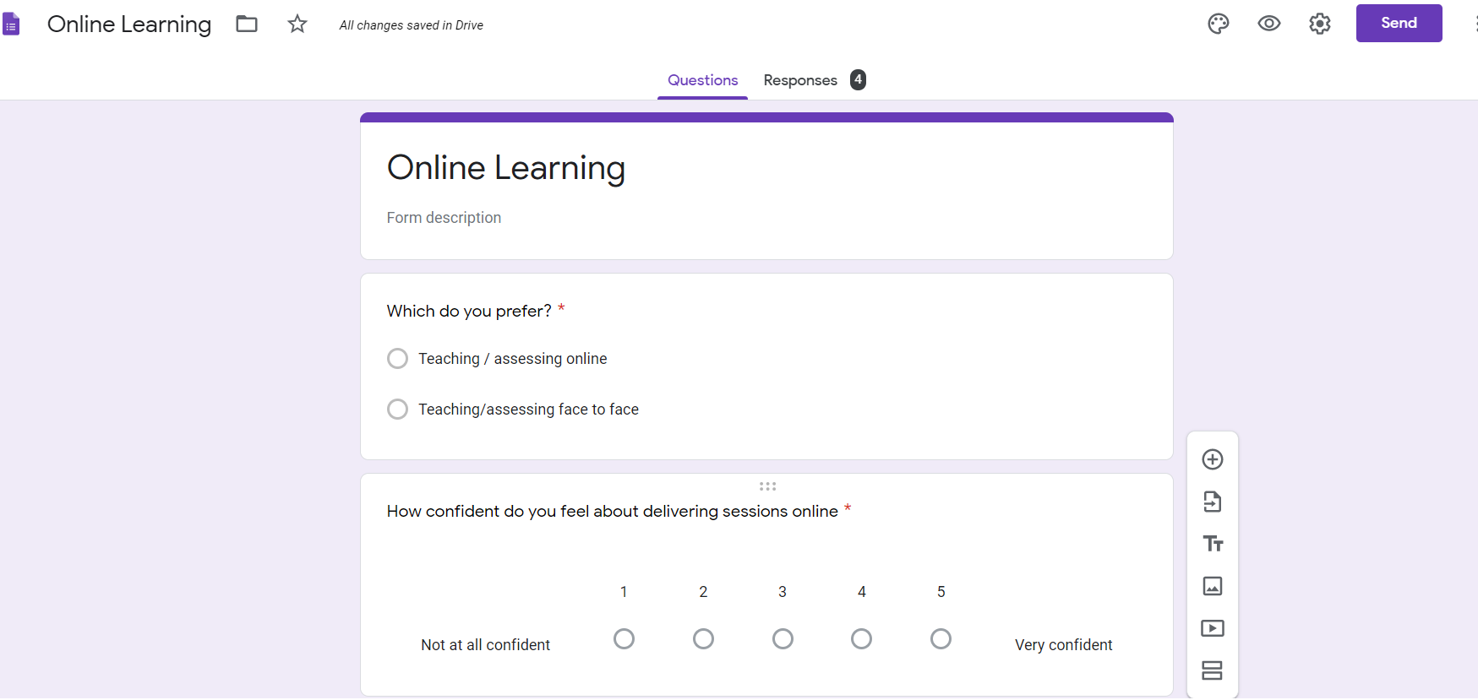
Google Forms-Assessment, visual results, discussion points

Slide 21
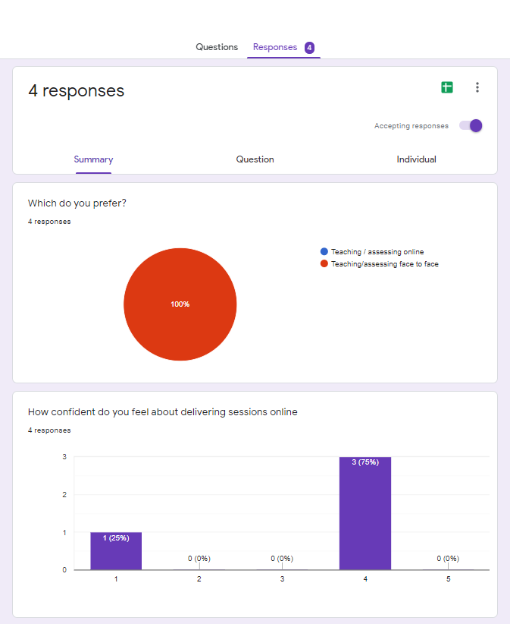
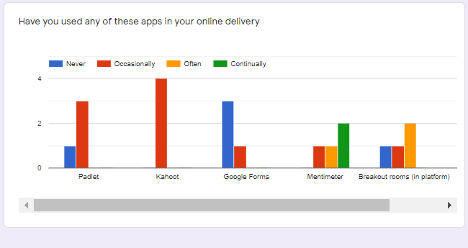
Google Forms-Assessment, visual results, discussion points

Slide 22

Design & Structure

Slide 23
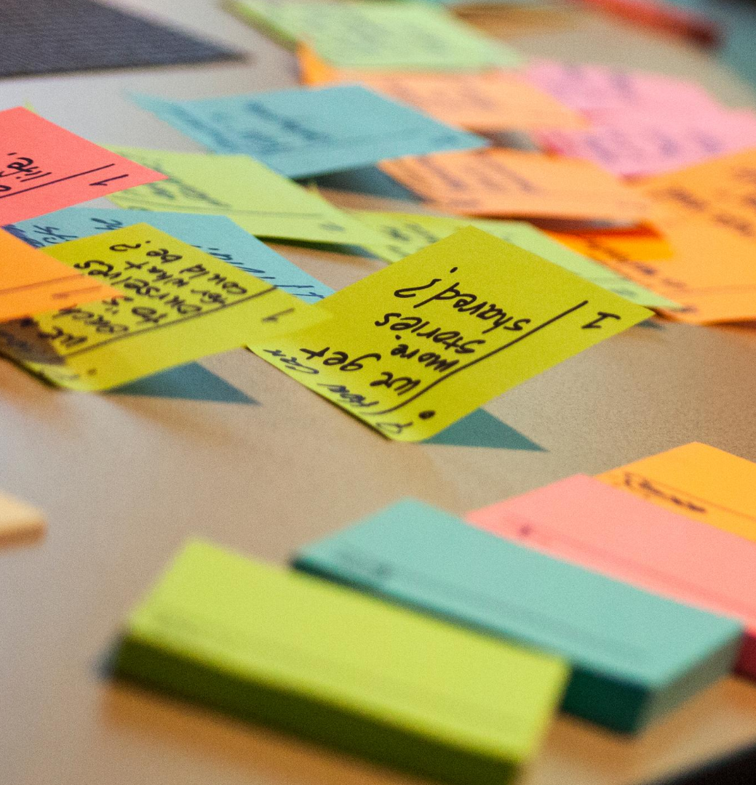
Session Design
Don’t just transfer your sessions –adapt!
Back to basics…Planning (Things may take longer!)
Learning objectives-what will the learners do by the end of the session? How will you assess? Formal/informal
Lesson plan
How long?

Slide 24

Does ‘traditional’ teaching translate?
Its all about the learning
Differentiation-
  pairing, groupwork through breakout rooms/private chat conversations between pairs, activities
Learning styles-
  VARK Visual, audio, read/write kinaesthetic
Participation
Motivation
Constructive feedback
Assessment for Learning

Slide 25
Top-Top Tips
1
Practice with your platform-use different devices to understand what your learners experience
2
ALWAYS have a session plan with learning objectives!! Work backwards from there
3
Use a variety of activities-even if they are with the same tool (e.g. chat)
4
Use a producer to take the pressure off and make it look more professional
5
Have a professional mindset-it’s still your classroom
6
Use interactive tools like padlet if you can-to engage kinaesthetic learners

Slide 26

Remember…be professional to the end!
Notes:
Remember-be professional to the end-ifi you can

Slide 27


https://bit.ly/virtualpanda

