Slide 1




Considerations for
Digital
Safeguarding
Dr Shan Jones
Notes:
Hi Eveyone – good morning
This morning I’m going to talk to you about safeguarding in the digital world.
I would just like to congratulate Ros and Rachel on their work anniversary – and thank them for inviting me along to talk to you.
The areas that I will be covering on our whistle stop tour this morning are:
Key duties and responsibilities – including duty of care
And some of the key differences between digital and face to face safeguarding – how we define and recognise abusive behaviour
Public
Privacy
Professional and policy
We will also spend some time on confidentiality, boundary setting and reporting.
Life and teaching has made a huge step change over the past decade more recently online learning has taken centre stage in our new normal – Covid world.
safeguarding is no longer confined to face to face encounters but presents us with challenges in the digital virtual world
Students are increasingly in contact with you through a range of apps and platforms accessible through a range of devices –
we have become ‘digital by default’ - and with that come the challenges of misinformation, social isolation, uncertainty and risk.
We and our students now have the opportunity to connect right across the world, meeting people, sharing information and making money.
Inherent in this is risk of bullying, harassment, cyber hate, CSE and trafficking.
Cyberbullying is bullying online and any form of anti-social behaviour over the internet or via a mobile device.
It is an attack or abuse, using technology, which is intended to cause another person harm, distress or personal loss.
There are of course the difficulties for social media platforms engaging with corporate responsibility and reducing risk to its users.
Privacy and our understanding of this becomes increasingly complex and opaque.
Mix this with commercialisation and profiling – we have a myriad of opportunities for things to go wrong putting privacy and security and student and personal safeguarding at risk.
As teachers and leaders working with adults it is important that we have a firm grasp and understanding of safe technology use.
A need to be leaders in modelling positive media role modelling – establishing clear boundaries, expectations and confidentiality.
Forums and tools used often vary and include a range of electronic devices often linked to forums or chat rooms, from the privacy of their own home, or in public venues such as coffee shops and public transport.
The tool may be a computer or laptop, a mobile phone, a camera or recording device, a tablet or games-console or simply email or mobile text messaging.
We are going to be touching on some of these issues in this session, but with the limited time available it is not going to be an in depth coverage – for that we will need more time.

Slide 2

Duty of Care
Reasonable Measures
  Policy, training, support
Appropriate Actions
  Recognise, respond, report
Notes:
So what are our responsibilities in our roles working with adults in workplace settings.
Duty of Care
Reasonable Measures
Appropriate Actions
Also the requirement to pass on concerns – safeguarding is everybody's responsibility
So what are our responsibilities in our roles working with adults in workplace settings.
How do I fulfil my duty of care?
You must do ‘what is reasonable in all the circumstances’ to safeguard and promote the welfare of your students
Your actions should be those of a reasonable person in the circumstances
Take into account factors including age, health and how, where and with what resources their education is being delivered
You should always act in accordance with the procedures and guidelines provided for you by the organisation in which you are situated

Slide 3

Recognising…
Different Types of Digital Abuse
menti.com
Notes:
Discuss 3 Types
Upskirting?
Facebook
Online/ Cyber Bullying and Harrassment

Slide 4
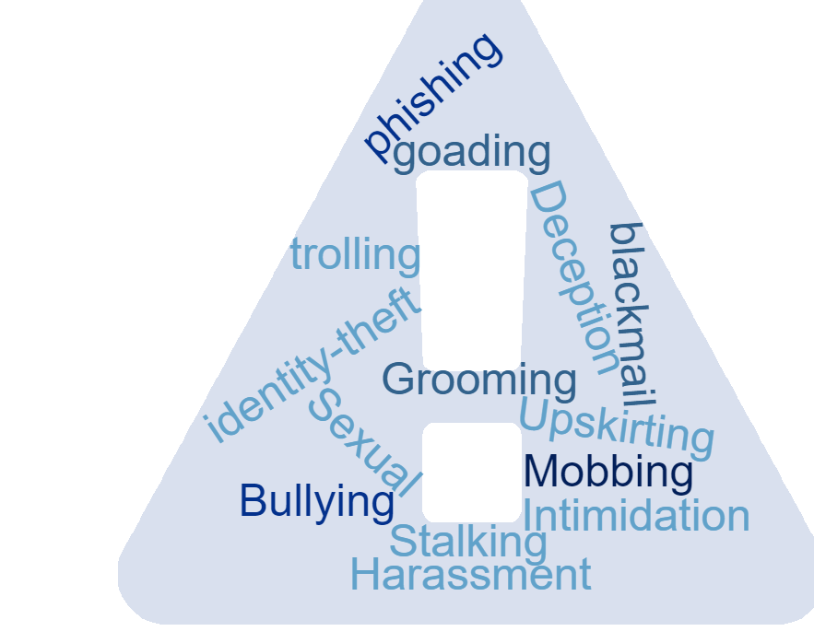
Recognising…
Notes:
Bullying
Harassment
Upskirting
Sexual abuse
Spreading malicious and abusive rumours and gossiping
Emailing or texting you with threatening or intimidating remarks
Mobbing (a group or gang that target you)
Harassing you repeatedly
Intimidation and blackmail
Stalking you on-line and continually harassing you
Posting embarrassing or humiliating images or video’s without your consent.
Posting your private details on-line without consent
General Bullying or Stalking
Grooming enticing or goading you on-line to self-harm or commit a crime
Setting up a false profile, Identity fraud or identity theft
Using gaming sites to attack or bully you
Theft, Fraud or deception over the internet
trolling,

Slide 5
Defining
If employees complain they are being bullied or harassed, then they have a grievance which must be dealt with regardless of whether or not their complaint accords with a standard definition.
Bullying
Offensive, intimidating, malicious or insulting behaviour, an abuse or misuse of power through means that undermine, humiliate, denigrate or injure the recipient.
Harassment
Harassment as defined in the Equality Act 2010 is:
Unwanted conduct related to a relevant protected characteristic, which has the purpose or effect of violating an individual’s dignity or creating an intimidating, hostile, degrading, humiliating or offensive environment for that individual.
Notes:
These are generic definitions
There is no agreed definition for bullying in the workplace
You will also need to be aware of the definitions found in safeguarding around physical, emotional, sexual abuse and neglect.
These should be found in policy guidance both in your organisation settings – and in workplace settings – this can sometimes be problematic when you have small organisations with few organisational policies
So conversations with your students about acceptable and unacceptable behaviour at the start of a placement is important.
Clear guidance about boundaries, confidentiality and passing on concerns is vital to give students the confidence to highlight issues early and seek help and support.
This also means that you need to have a secure understanding of what the expectations of your organisation are and how to recognise, respond and report concerns.

Slide 6
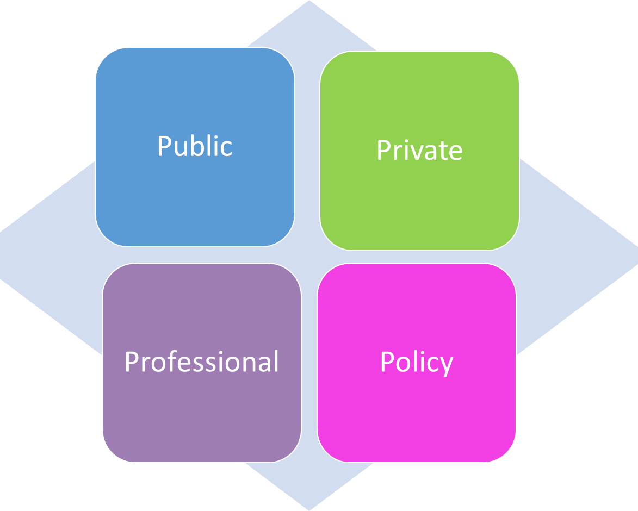
Considerations
Notes:
There are four main areas that we need to think about and model with students and apprentices.
What is in the public domain – what could you find out about your students – what could they find out about you? Name, date of birth, school, children, inappropriate posts or pictures, contacts/friends – what do you want to keep private? How often do you check your privacy settings.
Using a pseudonym – as a work contact
Your professional information listed by tour employer/organisation or college.
Private: Think of it as inviting a guest into your house – you wouldn’t necessarily give them a tour of your bedroom or private/confidential information.
If you have not checked out and limited access to the information out there in the virtual world – there is a wealth of information that you can find out –
It’s a good exercise to do as a team in your workplace – just spend 15 mins seeing what information you can glean about your colleagues online! You will be surprised!
Policy: Have you read an understood your acceptable use policy/ safeguarding/ Dignity at work policy – your understanding of the expectations written in these policies is vital if you are to safeguard your students – there will be expected standards and requirements to act covered in all of these – above and beyond your duty of care.
Because you are working primarily with adults – the issues of reporting on can be challenging – what are the organisations expectations – how do these differ from the students?
Having that initial conversation with the student about this will make clear what is expected of you, and more importantly signal to the student that they have a listening and supportive relationship to access with their concerns.
Do you know how and who to report concerns to – this will usually be through the organisation they are training/working for.

Slide 7

Personal and Professional Boundaries
Explore what is acceptable/unacceptable
Know how to report and block
A conversation about what they’re sharing
Let them know they can talk to you
Offer additional support networks

Slide 8

Poll:
In the last 3 months have you?
Communicated in new digital ways with your learners?
Checked privacy settings on the digital tools you are using with learners
Checked your safeguarding policy for guidance about working online with learners?
Checked your own privacy settings on all your apps / social media accounts ?
Created a separate account/pseudonym for professional use?

Slide 9
Top Tips
To create a safe space check security settings on the platforms you are using with learners
Provide them with guidance on how to change their backgrounds to maintain privacy in their home environment
Ask for permission to record sessions
Use your best judgement. If you’re about to publish something on social media that makes you uncomfortable or you’re not sure about, take some time and think over whether it’s what you really want to say.

Slide 10
Any questions?
Thank you

Slide 11

Understanding Safeguarding Level 2
Next course:
Monday 14th and Wednesday 16th September (10-11.30 online)
Monday 21st and Wednesday 23rd September 2-3.30 pm
Book at: https://bit.ly/safepanda2
Notes:
https://bit.ly/Pandasafeguard

Slide 12
Useful sites
https://www.ncsc.gov.uk/news/home-working-increases-in-response-to-covid-19
https://respectme.org.uk/adults/online-bullying/
https://www.ageuk.org.uk/globalassets/age-uk/documents/information-guides/ageukil4_internet_security_inf.pdf
https://www.getsafeonline.org/

