Slide 1
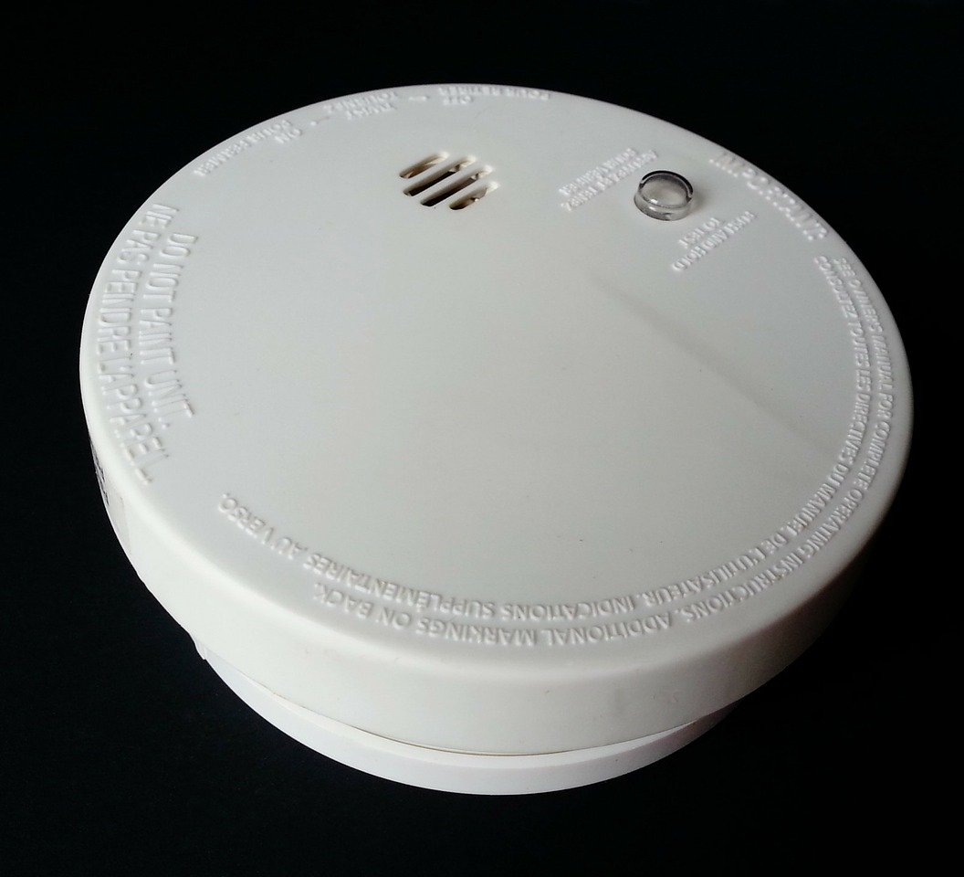

Stop
the pandemonium!
Smoke Alarms, Seahorses
and Self-help!
Notes:
Presentation intro regarding stress and anxiety and how we can develop strategies for ourselves and our learners as we start to move forward to going back out into work and life.

Slide 2
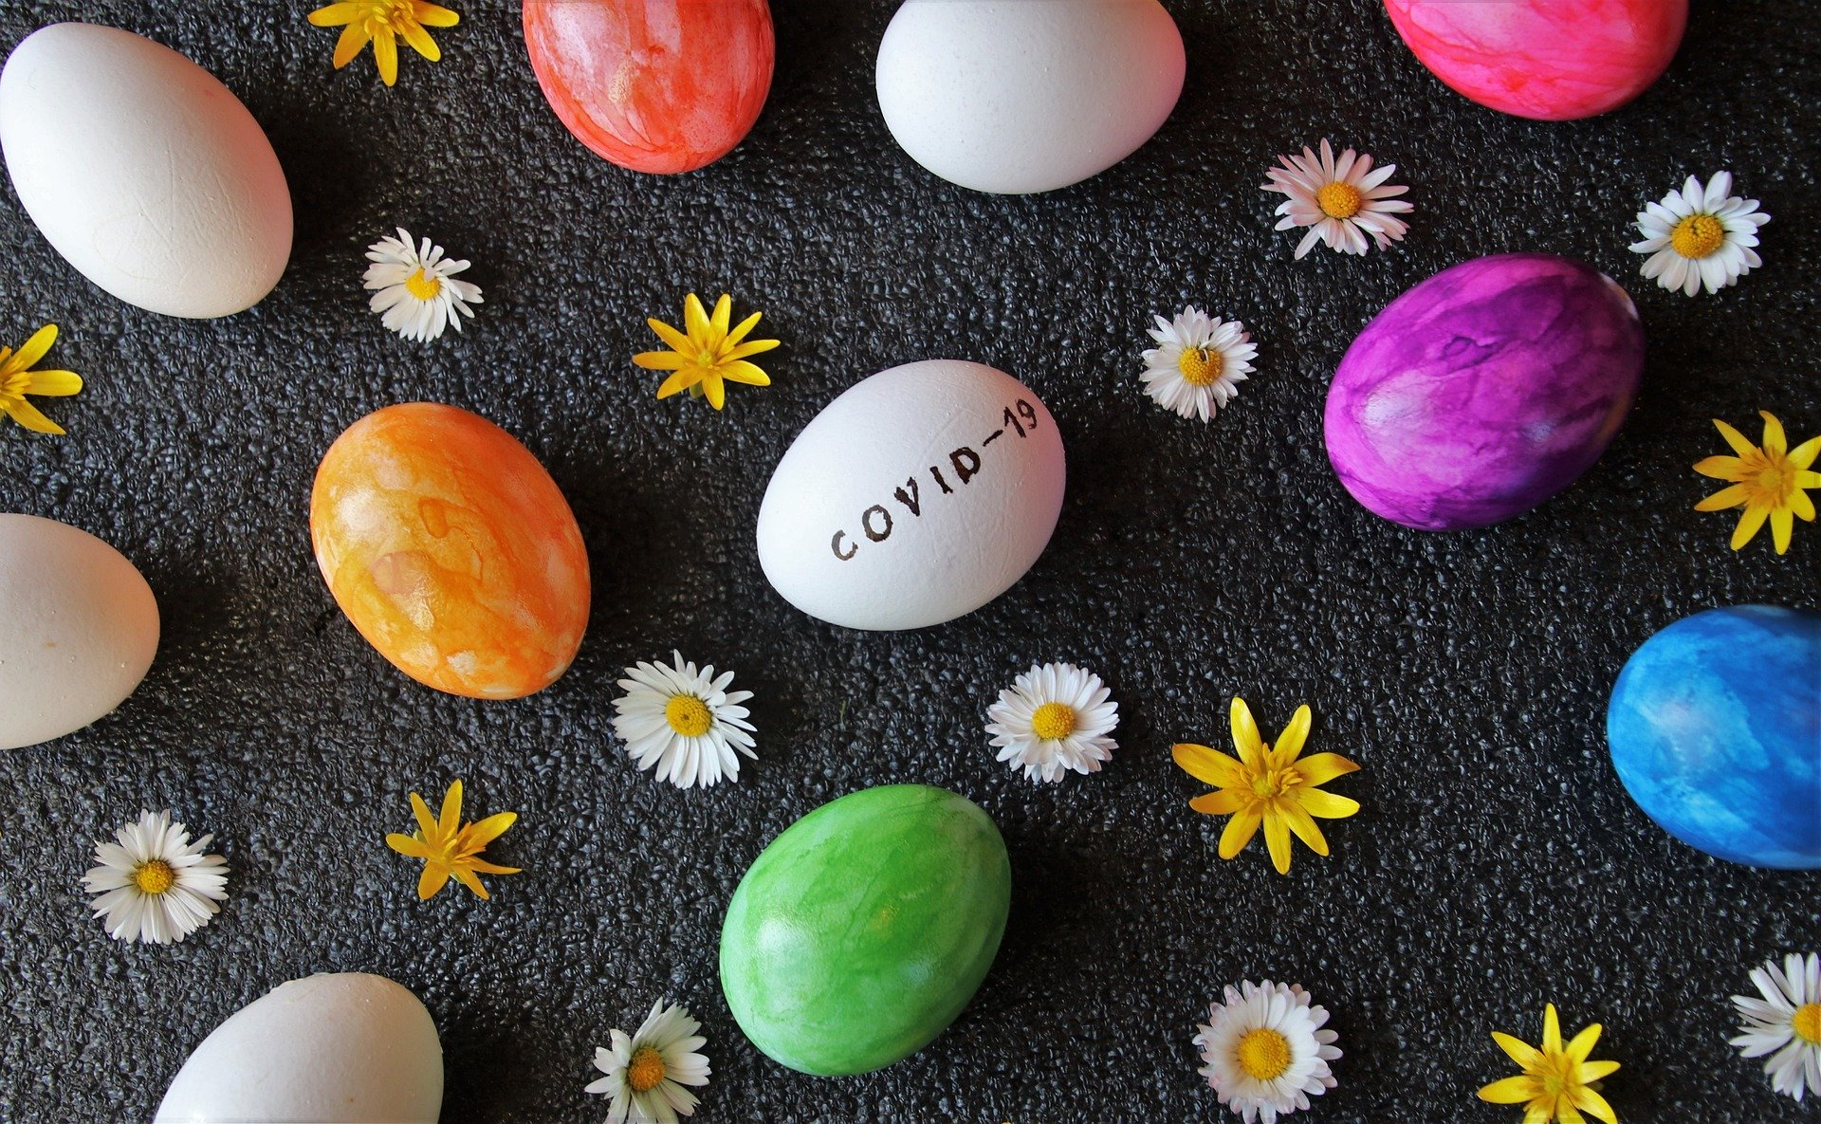
These are strange times
Notes:
Global scale of the pandemic means we are all potentially feeling anxious – especially when we are thinking about going back ‘out’
Huge changes, loss (of freedom and routine as well as loved ones), collective trauma on an unprecedented global scale

Slide 3
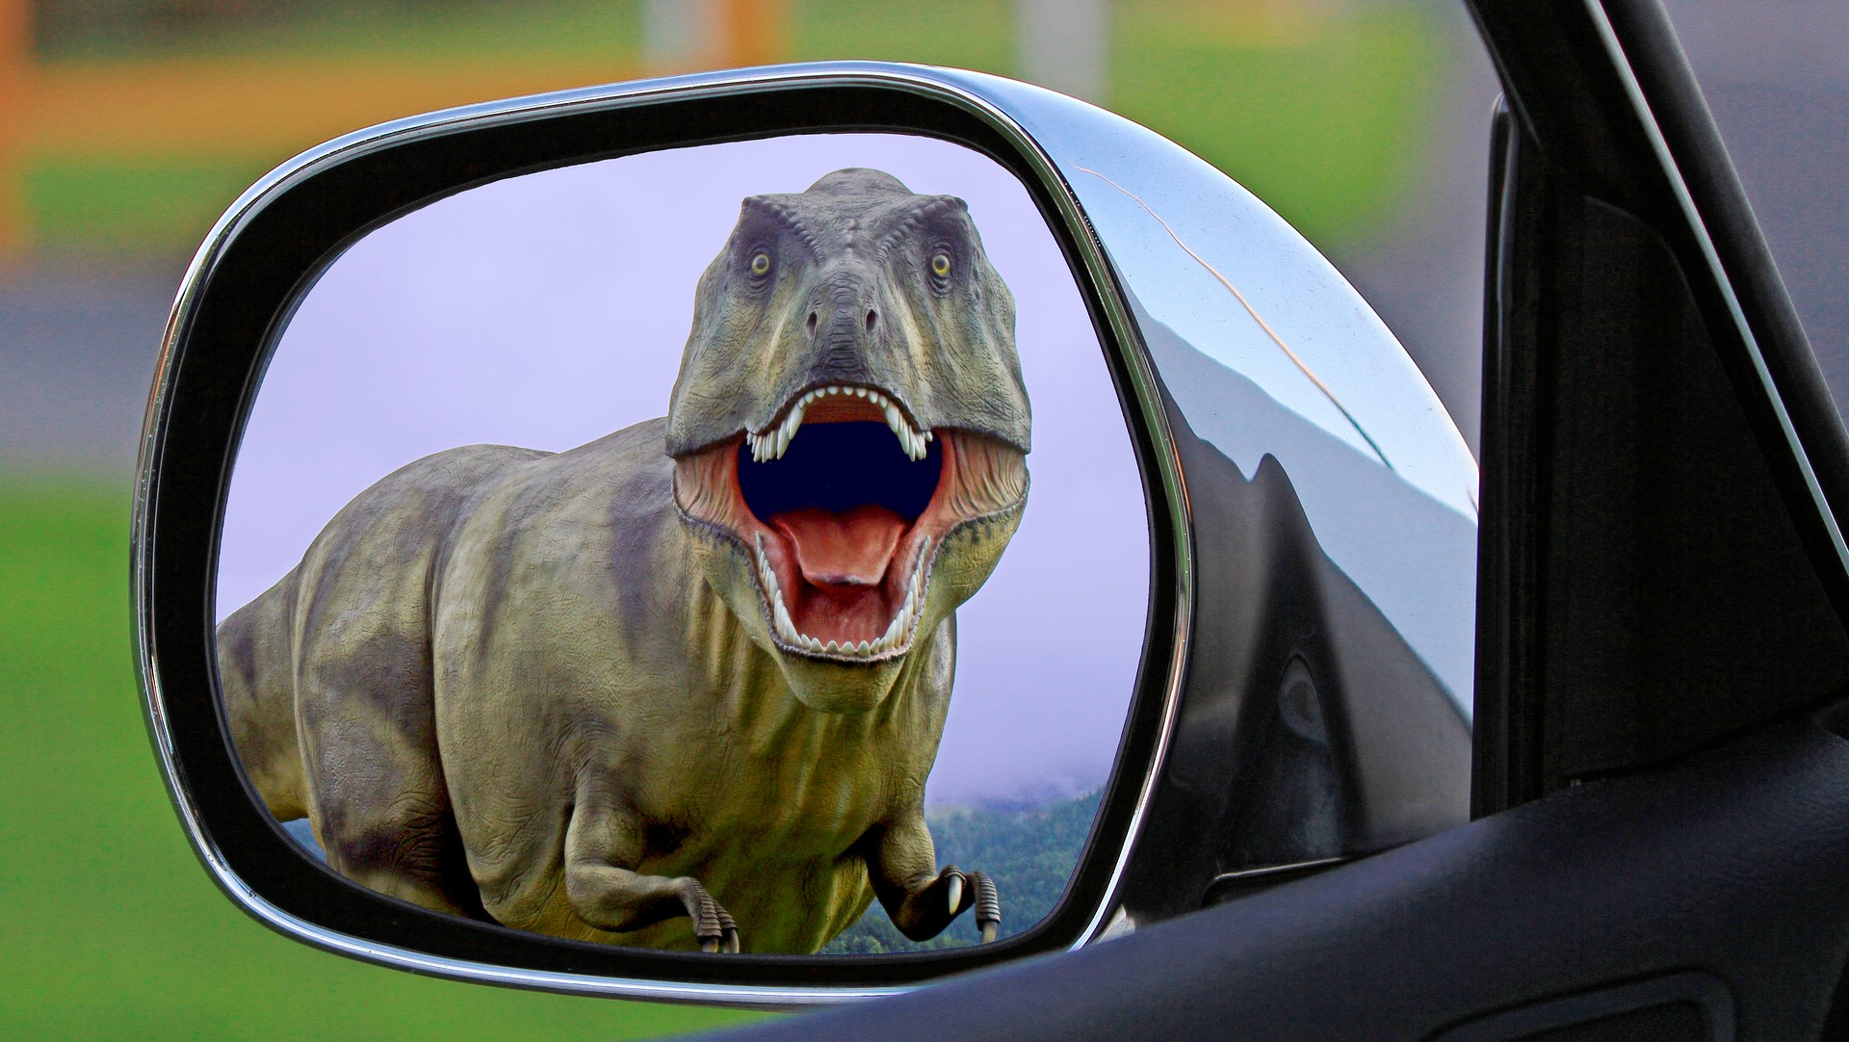
Your own personal smoke alarm – the amygdala
The question is … is your toast overdone or is your house on fire?
Notes:
Brain information – the amygdala – what it is and how it is like a smoke alarm – being triggered but sometimes a little overactive.
Gives us a tendency to notice bad things in our lives and not focus on the good.
Outline we are all in a state of change, loss and trauma – anxiety is high amongst many, lots of loss and collective trauma
Our amygdala does not like change – 18months to overcome any major change – so it will take us all time to come to terms with the collective Covid effects
Dinosaur pic – Of course we would notice this – it really is a danger – we really should do something – but when our amygdala overreacts it can be a significant problem for us in living our lives and working day to day.

Slide 4

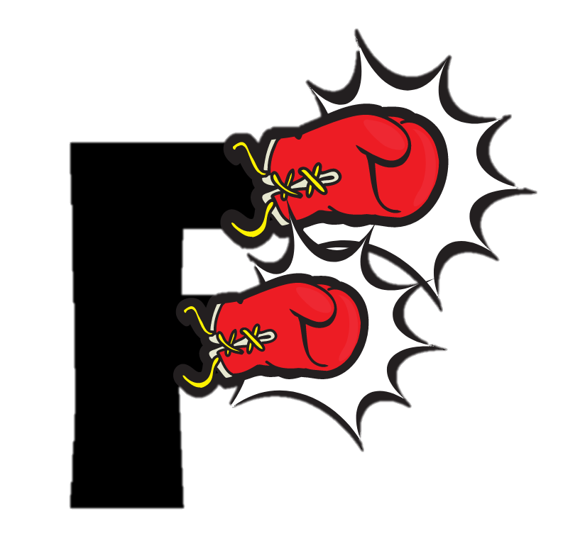
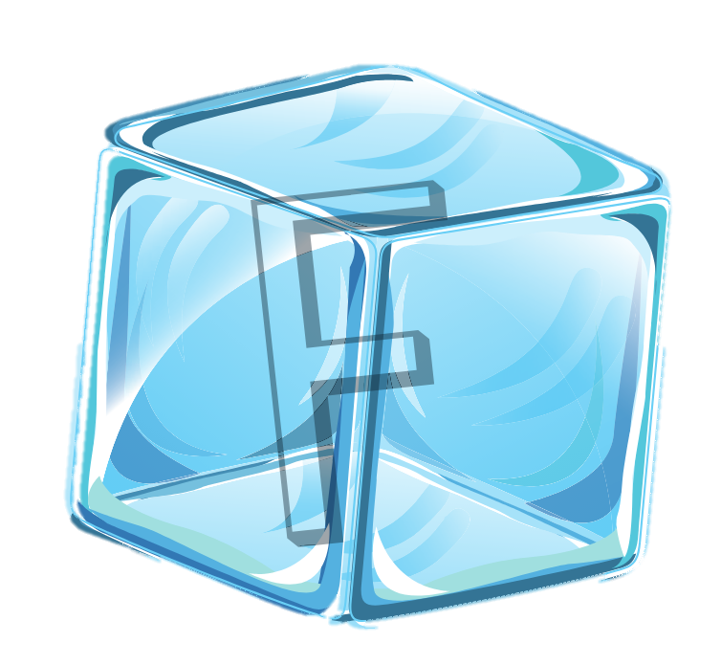
The smoke alarm goes off … The result – The 3 Fs
light
ight
reeze
Notes:
And when the smoke alarm goes off –
How do we react? - 3 basic reactions
Run away
Anger
Do nothing/hide

Slide 5


The symptoms menti.com
Notes:
Physical symptoms of anxiety and stress – what are they?

Slide 6
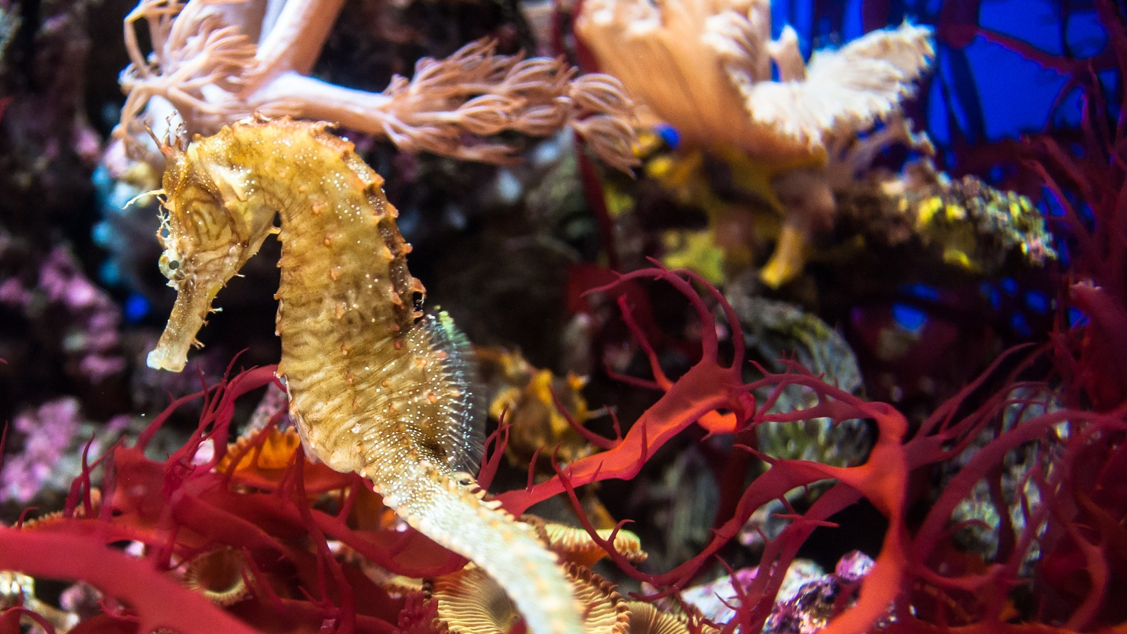
Seahorses - the hippocampus
The hippocampus plays
a critical role in the formation, organization, and storage
of new memories as well
as connecting certain sensations and emotions
to these memories.
https://www.verywellmind.com/what-is-the-hippocampus-2795231
Notes:
Side by side – the amygdala and the hippocampus – one of each on each side of the brain.
Triggers for anxiety are often memories – trauma memories are stored in a different way to other memories and can be triggered very easily by smell, sound, taste, sight or touch - smell is the most powerful
Symptoms are extreme – like reliving the situation exactly in the same physical and emotional way
May not be able to identify the trigger – at least not immediately – can come on very suddenly

Slide 7

Let’s reset!
Using nice memories menti.com
Notes:
Nice memories triggered by senses

Slide 8





The solutions - we’re all different
Visualisation
Gratitude
Progressive Muscle Relaxation (PMR)
Breathing
UCOPE
Therapy
Notes:
So if we are anxious how can we reset?
Strategies and solutions to stop the pandemonium – will depend on you and what makes you anxious.
Is it immediate or underlying?
Is it long or short-term?
Is it conscious or subconscious?

Slide 9
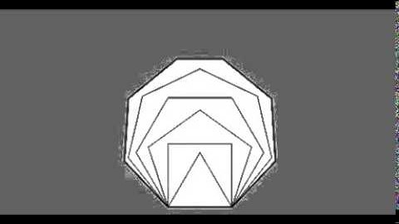
UCOPE
Understand
Check Reality
Organise thought
Prevent pressure
Engage with the environment
Notes:
Breathing – helps to regulate if you are doing shallow breathing, helps to calm your pulse, shifts focus away from the source of the anxiety or stress.
Acronym to help with remembering what to do – puts a person back in control – anxiety makes you feel out of control
Understanding your amygdala and what your triggers are and how they can affect you, including how your body reacts and the very early warning signs/symptoms
Checking reality in situations where you know you may be triggered – checking is it the toast or the house when the smoke alarm goes off – breathing before we react
Organising your thoughts – breathing helps give oxygen to the brain to help you think then you can find a solution
Prevent pressure is reducing the panic which happened in the first place, by thinking it through in a logical, organised way
Engage with the environment - having calmed ourselves we can carry on with whatever we need to do next.
All to practise breathing to the video https://youtu.be/u9Q8D6n-3qw

Slide 10
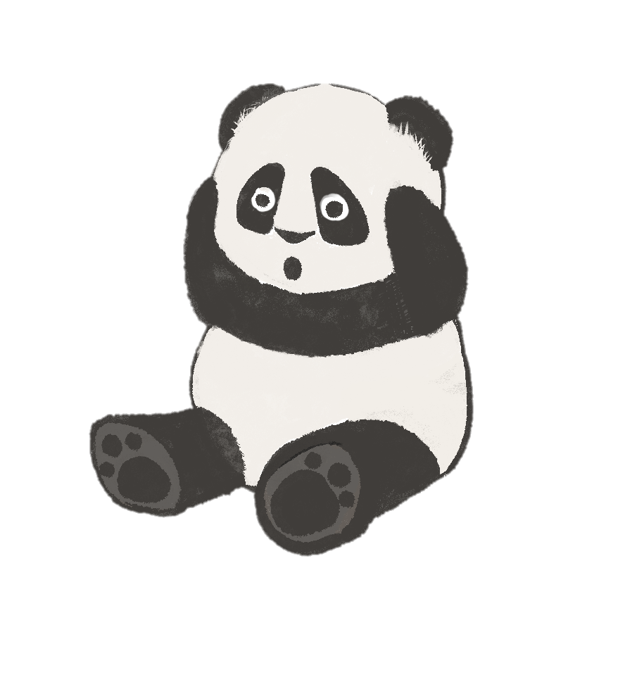
Anxious or stressed?
… Plan ahead
What strategies could you try?
Which ones will you use?
How will you remember them?
Think
Choose
Remember
Notes:
The solutions you choose might also include regular mindfulness, yoga, exercise or healthy food all know to help our minds and bodies be healthy.
What are your strategies? Are they short-term or long-term?
If you need them how will you remember them in a moment when the smoke alarm is flashing and screaming for your attention?

Slide 11
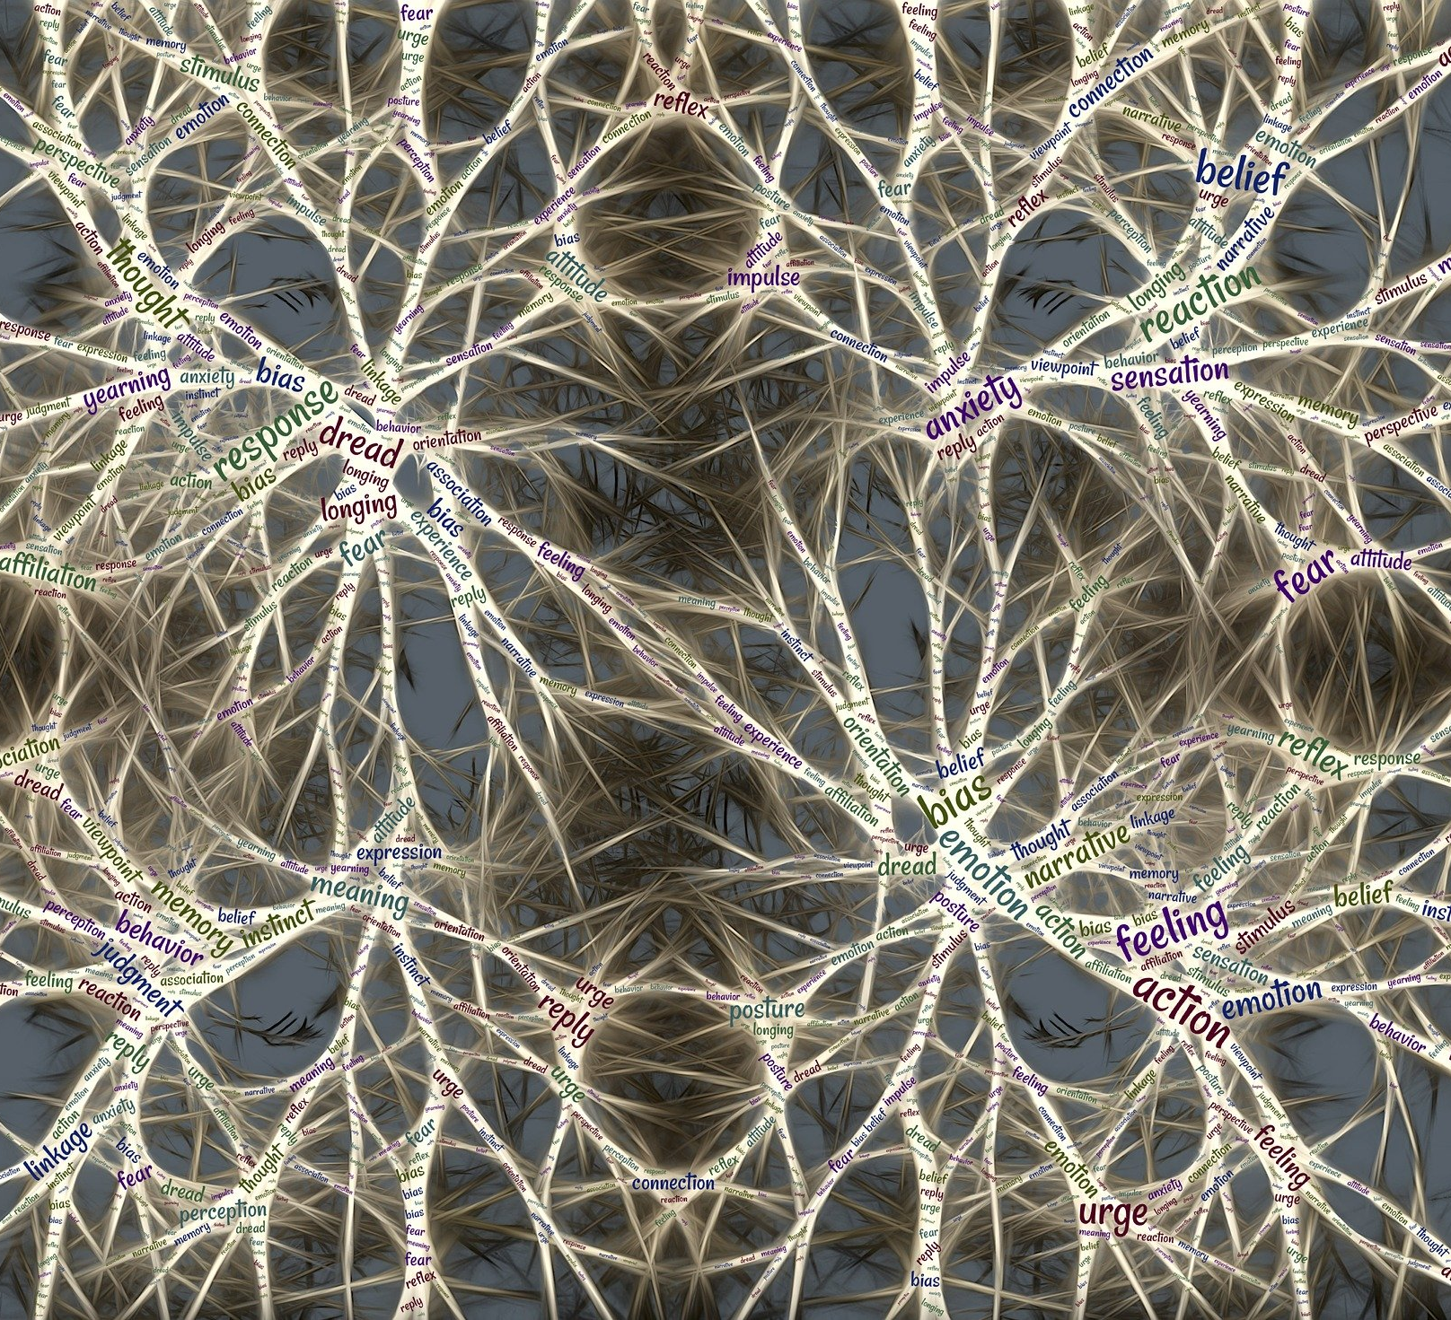
How practice helps
Notes:
Practice builds the mind’s ability to react positively and to recognise and change our own behaviour. It can build and reinforce connections in our brains to help us overcome our natural, reactive, instinctive behaviours.
This is the basis of CBT – Cognitive Behavioural Therapy – Thoughts, Feelings and Actions.
You could use the handout/worksheet you have been given to identify some of your own strategies and actions which might help both short and long term.
And share this information with your learners if you think it will help them.

Slide 12
… and now … breathe

Slide 13
Mental Health & Wellbeing Level 2
“
Next course: starts Wednesday 4th November
“
Feeling that I was in a safe, non-judgemental environment to learn and discuss very sensitive and heavy topics
The interaction-I lose concentration easily, so having the whole class interact at all times really helped with my learning
For more info: http://bit.ly/pandaMH

